Slide 1



Higher Education System Analytics
Enlightening Technical Solutions at Texas A&M University-Commerce
by
Arbaz Hamid Bamboowala
Texas A&M University-Commerce

Slide 2

Higher Education System Analytics
Enlightening Technical Solutions at Texas A&M University-Commerce
Introduction
Problems and Issues Identification 1
Business Solution - Workflow 1
Benefits of Implementation
Data Collection & Analysis
Texas A&M University-Commerce

Slide 3
Higher Education System Analytics
Enlightening Technical Solutions at Texas A&M University-Commerce
Problems and Issues Identification 2
Business Solution - Workflow 2
Benefits of Implementation
Answers to the Questions
Conclusion
Texas A&M University-Commerce

Slide 4
Higher Education System Analytics
Enlightening Technical Solutions at Texas A&M University-Commerce
Introduction
Exploring Technical Business Innovative Solutions to Solving Problems in Everyday Job Routine.
The ISSS department is dedicated to providing international students with the resources and support they need to excel academically.
This presentation will explore identifying areas where I worked at ISSS department to enhance its support services.
Texas A&M University-Commerce

Slide 5

Higher Education System Analytics
Enlightening Technical Solutions at Texas A&M University-Commerce
Problems and Issues Identification 1
Extensive Paperwork
Difficulty in Tracking Records
Time Consuming and Tiring Process
Requires Memory Space to Download
Internal High Costs and Budgeting Issues
Texas A&M University-Commerce

Slide 6
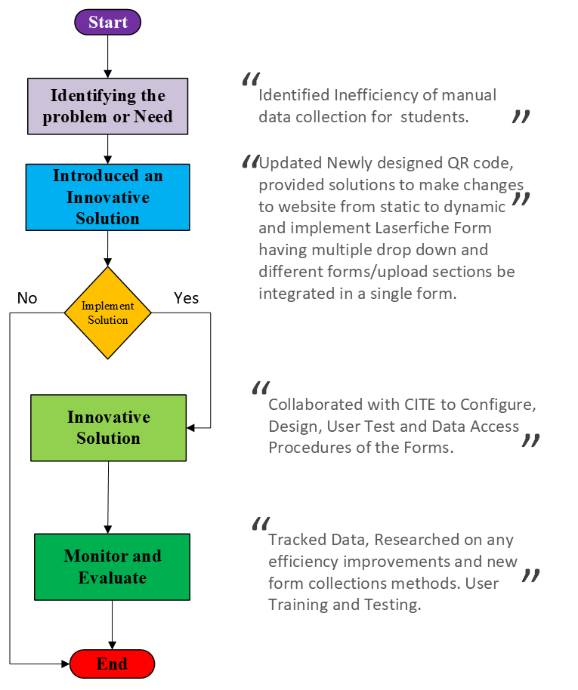
Higher Education System Analytics
Enlightening Technical Solutions at Texas A&M University-Commerce
Business Solution
- Workflow 1
Workflow Diagram
Implementing Business Solution
Texas A&M University-Commerce

Slide 7
Higher Education System Analytics
Enlightening Technical Solutions at Texas A&M University-Commerce
Data Collection & Analysis 1
Created a Sample International Students Data
Used KPI’s such as
Percentage of Course/Credits Completion,
Completion Rate by Country,
Retention Rates
Texas A&M University-Commerce

Slide 8
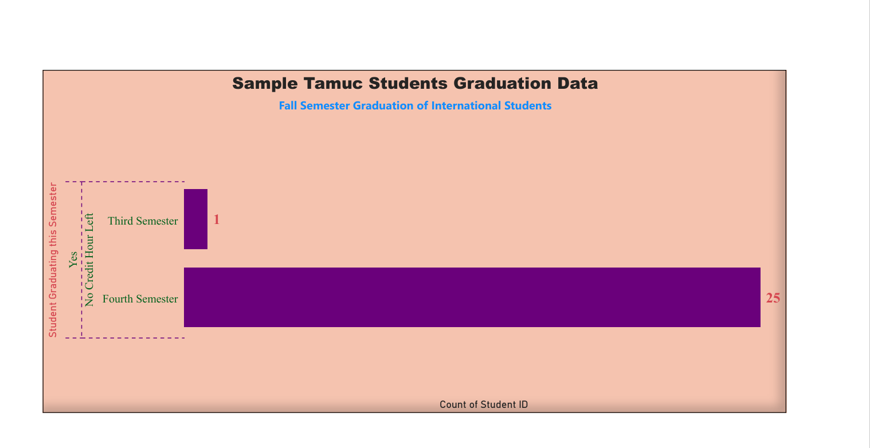
Higher Education System Analytics
Enlightening Technical Solutions at Texas A&M University-Commerce
Data Collection & Analysis 1

Slide 9
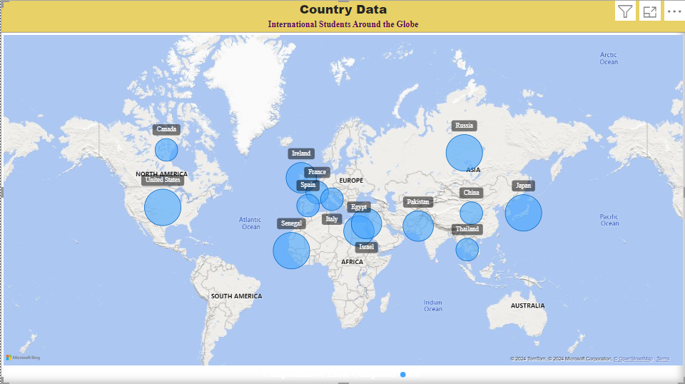

Higher Education System Analytics
Enlightening Technical Solutions at Texas A&M University-Commerce
Data Collection & Analysis 1

Slide 10
Higher Education System Analytics
Enlightening Technical Solutions at Texas A&M University-Commerce
Benefits of Implementation 1
Ease of Access
Portability
Time Efficiency
Tracking and Management
Cost & Effort Saving Approach
Texas A&M University-Commerce

Slide 11
Higher Education System Analytics
Enlightening Technical Solutions at Texas A&M University-Commerce
Problems and Issues Identification 2
(Filling out Multiple Immigration Forms)
Tedious & Time Consuming
Unclear Process Flow and Difficulty in Navigating
Inconsistent or Incorrect Data Entry
Burden to the Faculty/Staff for Management
Unsorted Data Management
Texas A&M University-Commerce

Slide 12
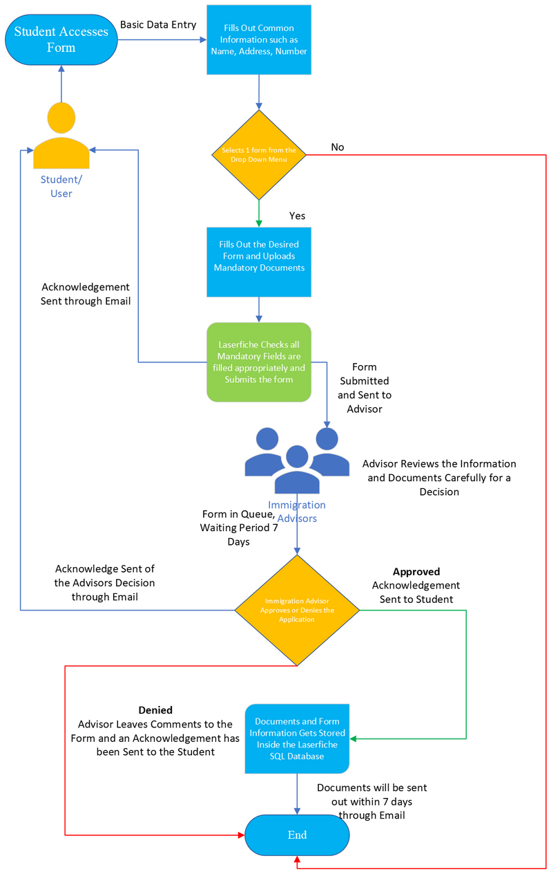
Higher Education System Analytics
Enlightening Technical Solutions at Texas A&M University-Commerce
Business Solution
- Workflow 2
Integrating Multiple Immigration Forms Together
Workflow Diagram
Implementing Business Solution
Texas A&M University-Commerce

Slide 13
Higher Education System Analytics
Enlightening Technical Solutions at Texas A&M University-Commerce
Benefits of Implementation 2
Ease of Access
Time Efficiency
Tracking and Management
Simple Process Flow
Consistent Data Entry and Less Likely for Incorrect Data
Texas A&M University-Commerce

Slide 14
Higher Education System Analytics
Enlightening Technical Solutions at Texas A&M University-Commerce
Conclusion
By implementing this new immigration form workflow, fostering a more collaborative environment for both users and advisors.
The system ensures clear communication, faster processing times, and efficient access to information.
This ultimately benefits everyone involved in the ISSS Department.
Texas A&M University-Commerce

Slide 15
Higher Education System Analytics
Enlightening Technical Solutions at Texas A&M University-Commerce
Lastly, Education is the most powerful tool which you can be used to implement a positive change.
Educate
Discover
Achieve
Texas A&M University-Commerce

Slide 16
Higher Education System Analytics
Enlightening Technical Solutions at Texas A&M University-Commerce
THANK YOU
Texas A&M University-Commerce

